Slide 1
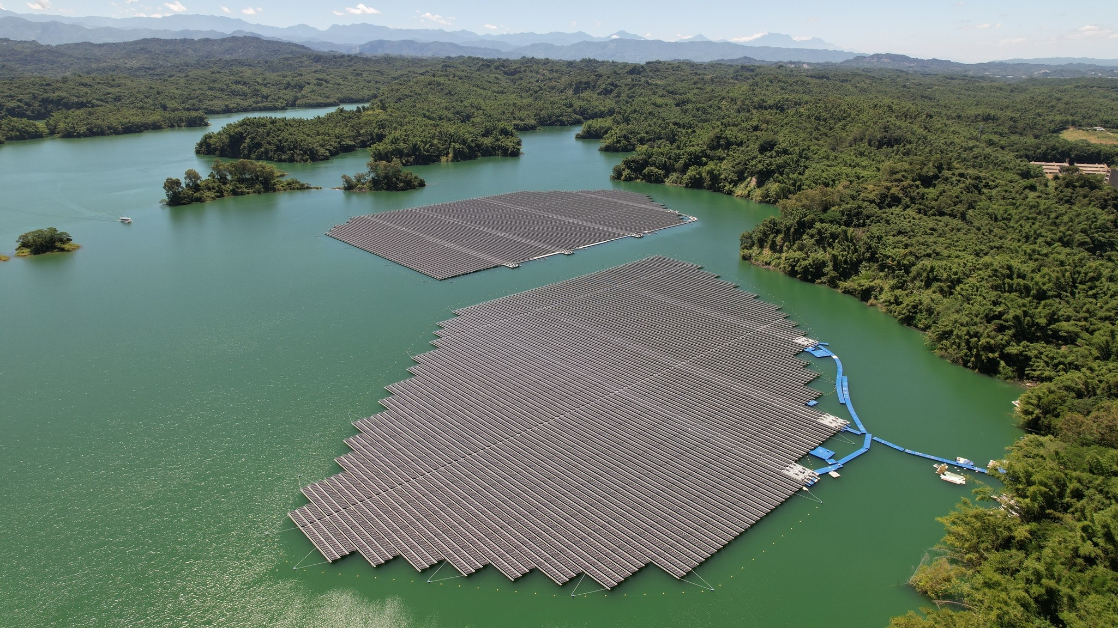
Schematic Design:
Title
Cover slide sub-title
13MW Floating PV, Wu Shan Tou Reservoir, Tainan City, Taiwan
Installed by Star Energy

Slide 2
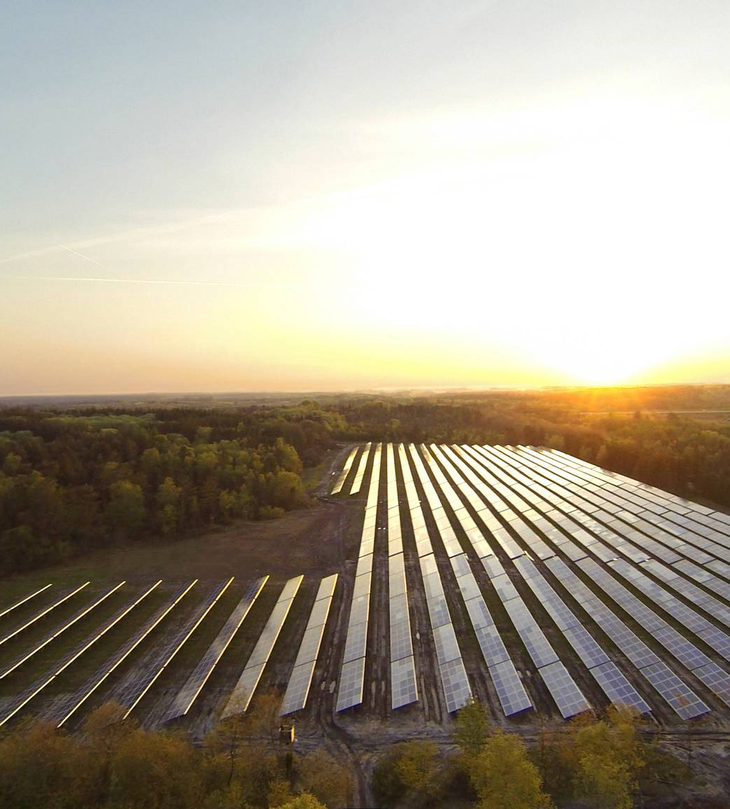
Agenda
Project Overview
Calculations and Components Selection
Schema
Layout
Summary
2MW, Kllund, Denmark
Installed by Sveigaard

Slide 3
Project Overview
Present group members
Present workshop task

Slide 4
Calculations and Components Selection
Calculations
  What did you calculate
Component selection –
  Criteria - Explain why you choose these components – which criteria's guide you (Reliability, Size, Cost…)?
BOM Cost

Slide 5
Schema
Explain implementation according to course’ guidelines
Add pictures

Slide 6
Layout
Explain implementation according to course’ guidelines
  Placement Guidelines
  Routing Guidelines
  Constrains Table
Add Pictures

Slide 7
Summary and additional inputs
Text

Slide 8
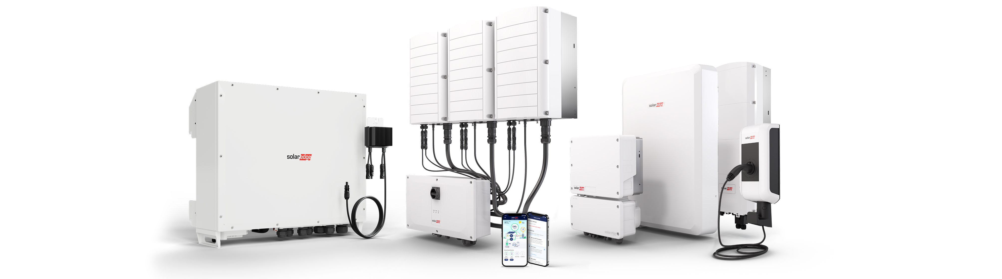
Thank You

